Slide 1
Toronto vs NewYork
The battle of neighborhoods
Apr, 2019

Slide 2
AGENDA
01
PROBLEM & BACKGROUND
02
DATA DESCRIPTION
& METHODOLOGY
03
RESULTS
04
DISCUSSION & CONCLUSIONS

Slide 3
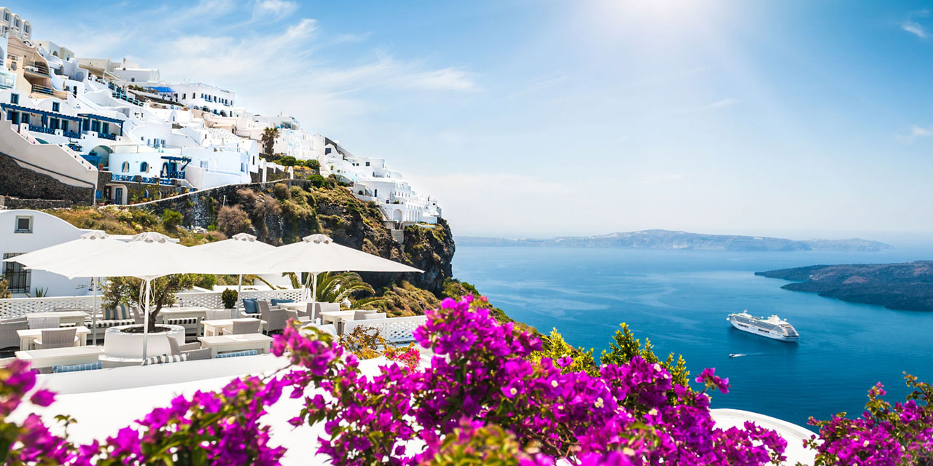
1. PROBLEM & BACKGROUND
Do you want to travel but don’t know where you should go? Are you looking for a little clarity and inspiration to get your trip planning started?
Tourists always eager to travel to different places on the basis of available information, and the comparison (the part of the information) amongst cities always assist to choose the specific places or according to their choice.
Toronto OR New York ???
Both cities are very diverse and are the financial capitals of their respective countries.
We want to explore how much they are similar or dissimilar in aspects from a tourist point of view regarding food, accommodation, beautiful places, and many more.

Slide 4
2. DATA DESCRIPTION & METHODOLOGY
DATA DESCRIPTION
The services of Foursquare API to explore the data of two cities, in terms of their neighborhoods.
The information about the places around each neighborhood like restaurants, hotels, coffee shops, parks, theaters, art galleries, museums...
Selecte one Borough from each city to analyze their neighborhoods. Manhattan from New York and Downtown Toronto from Toronto.
Use machine learning technique, “Clustering” to segment the neighborhoods with similar objects on the basis of each neighborhood data.
METHODOLOGY
GitHub repository
Python folium library to visualize geographic details of its boroughs and creat a map of Toronto and Manhattan with boroughs superimposed on top.
Foursquare API to explore the boroughs and segment them
Unsupervised learning K-means algorithm to cluster the boroughs.
Examine each cluster and determine the discriminating venue categories that distinguish each cluster.

Slide 5
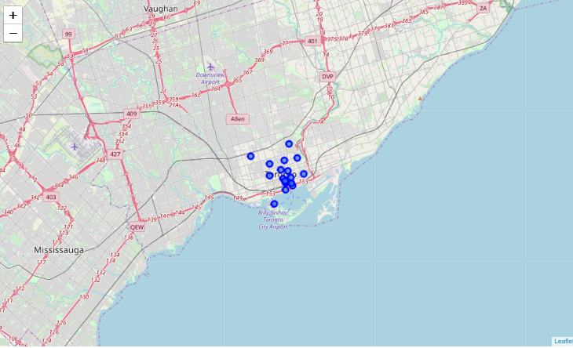
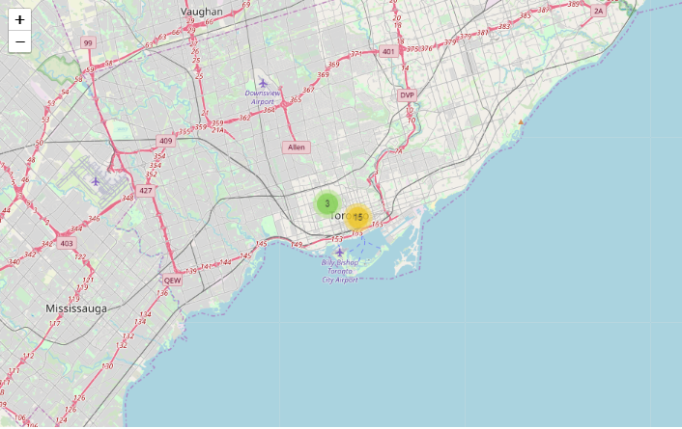
3. RESULTS
3.1 Toronto
Map with neighborhoods superimposed on top

Slide 6
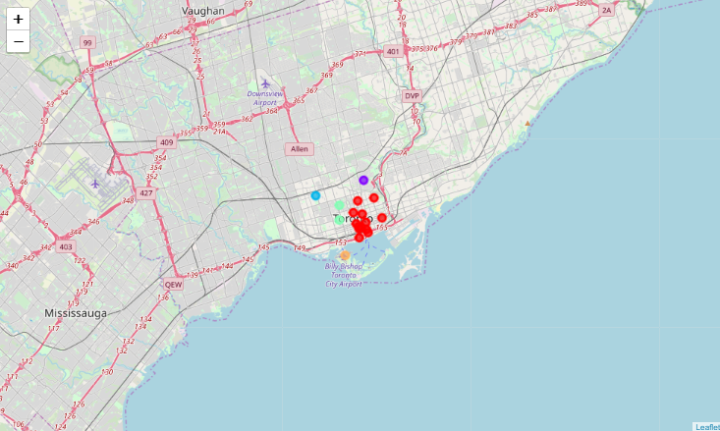
3. RESULTS
3.1 Toronto
Cluster Neighborhoods

Slide 7
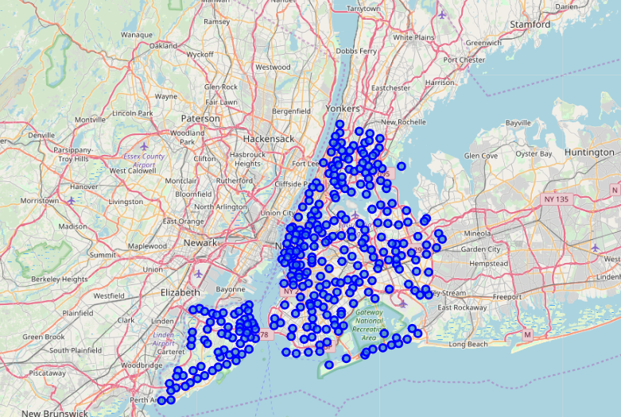
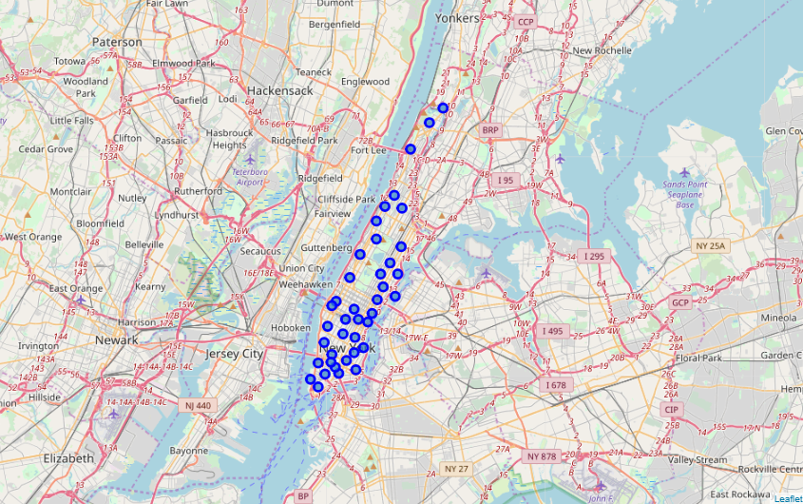
3. RESULTS
3.2 Manhattan
Map with neighborhoods superimposed on top

Slide 8
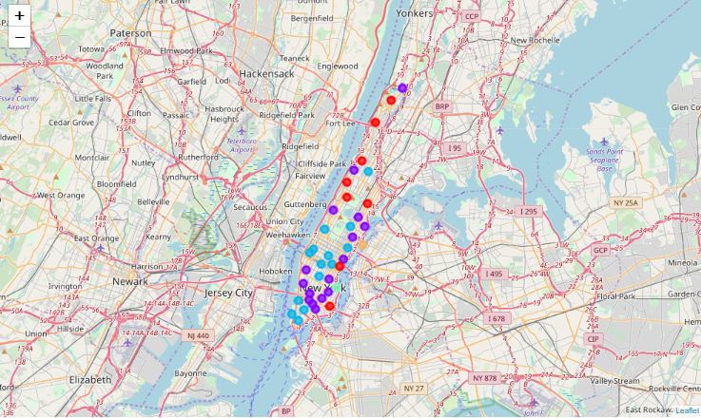
3. RESULTS
3.2 Manhattan
Cluster Neighborhoods

Slide 9
4. DISCUSSION & CONCLUSIONS
Results:
Both cities (Boroughs) have venues which can be explored and attract the Tourists.
Similarity: Theaters, opera houses, food places, clubs, museums, parks etc.
Dissimilarity: it differs in terms of some unique places like historical places and monuments.
Observations & Recommendations:
When we compare the tourist places, we observe that the historical place is only situated in Downtown Toronto and the Monument or landmark venue is in Manhattan neighborhoods.
Similarly, Airport facility, Harbor, Sculpture garden and Boat or ferry services are also available in Downtown Toronto while venues like Nightlife, Climbing gym and Museums are present in Manhattan.
As far as concern to recommendations, we recommend Downtown Toronto Neighborhoods will be considered first to visit. The tourists have an easily travelling access due to Airport facility, which not only saves time but also helps to save money. This saved money can be utilized to explore more, the attracting venues.¶
Conclusion:
The downtown Toronto and Manhattan neighborhoods have more like similar venues. As we know that every place is unique in its own way, so that’s argument is present in both neighborhoods.
The dissimilarity exists in terms of some different venues and facilities but not on a larger extent.

Slide 10
THANK YOU!

